Slide 1
Eliminating technical debt in Digital Humanities projects
Janelle Jenstad and Martin Holmes University of Victoria Humanities Computing and Media Centre

Slide 2
What is HCMC?
Set up in the mid-1990s​
Provides programming support for research and teaching in the Humanities​
Has published hundreds of digital resources over the years​
Many of these are large-scale digital editions, such as:​
The Map of Early Modern London (13,257 pages, mapoflondon.uvic.ca)​
The Colonial Despatches of BC and Vancouver Island (10,827 pages, bcgenesis.uvic.ca)​
The Landscapes of Injustice Archive (154,846 pages, loi.uvic.ca/archive)​

Slide 3
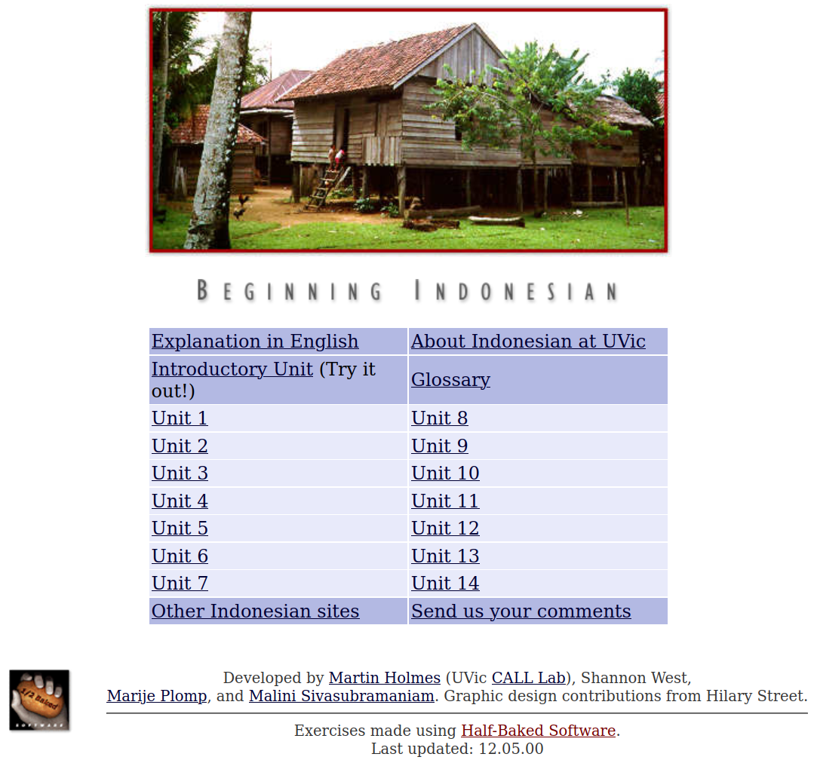
The 1990s
We made websites mostly to support language teaching.​
We build lots of interactive exercises using HTML, CSS and JavaScript.​
Most of these sites have never been updated – see for example:​
web.uvic.ca/hrd/indonesian/​

Slide 4
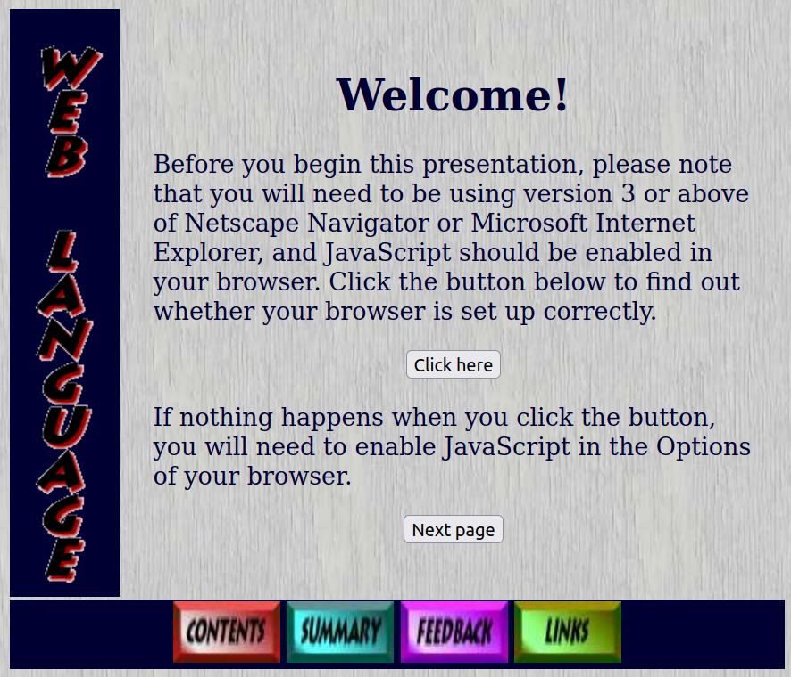
The 1990s
These sites all still work – even though they look SOOO 1990s:​
web.uvic.ca/lancenrd/martin/weblang/
No maintenance burden from these sites!

Slide 5
The early 2000s
Digital Humanities became a thing.
New technologies came along.
We got ambitious and enthusiastic, and started building larger, more complex sites with:
ASP
MySQL, PostgreSQL, PHP
Apache Cocoon
The eXist XML database
...and lots of other cool new tools.​

Slide 6
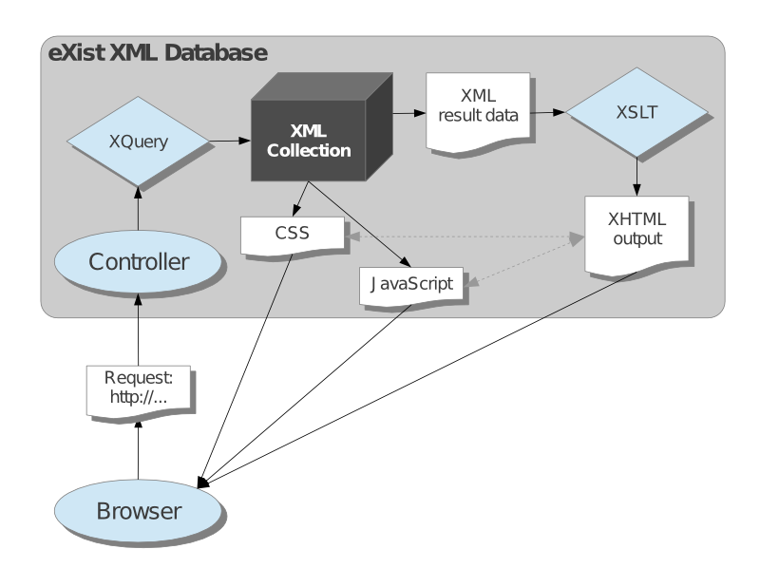

Slide 7
Sample Slide Title (no watermark)

Slide 8
Section Slide Title

